Slide 1
[for today] → Open notebook in Google Colab
ol1_binary_and_metric_indexing_exercise.ipynb
Link to the notebook in Teams chat.

Slide 2

DLMR Open Lab #1
Indexing Binary Vectors and Metric Objects
11 Luglio 2022

Slide 3

Fabio Carrara
fabio.carrara@isti.cnr.it
https://github.com/fabiocarrara
PhD in Computer Engineering @ UniPi
Deep Learning for Image Representation and Retrieval
PostDoc @ Istituto di Scienza e Tecnologie dell'Informazione (ISTI) - CNR
AIMH (Artificial Intelligence for Media and Humanities) Lab

Slide 4
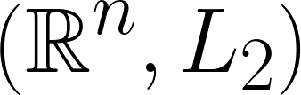
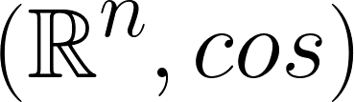
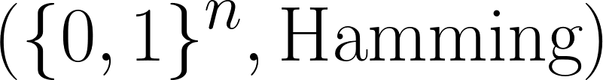
What we will do today
Metric Objects
(Strings, Edit Distance)
Euclidean Vectors
Binary
Vectors

Slide 5
What we will do today
Metric Objects
Index Binary Vectors (Hamming distance)
(Strings, Edit Distance)
Euclidean Vectors
Binary
Vectors

Slide 6
What we will do today
Metric Objects
Index Binary Vectors (Hamming distance)
Index Metric Objects (strings compared with edit distance)
(Strings, Edit Distance)
Euclidean Vectors
Binary
Vectors

Slide 7
Libraries & Technologies
numpy (multi-dimensional arrays)
FAISS (approximate nearest neighbor library)
MI-File (index for metric objects)
Services we will use (you will need a Google Account):
Google Colab (for a pre-installed environment and speed via GPUs)

Slide 8
To Colab

Slide 9
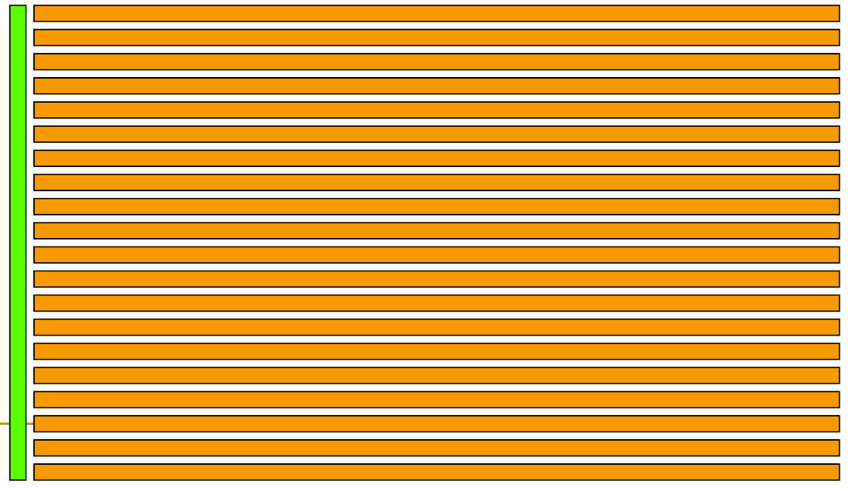
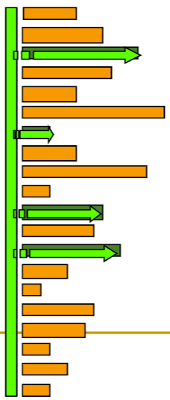
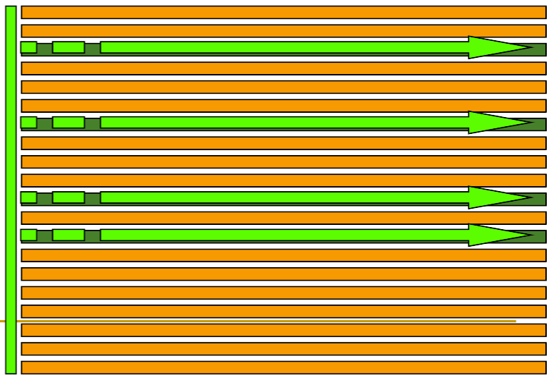
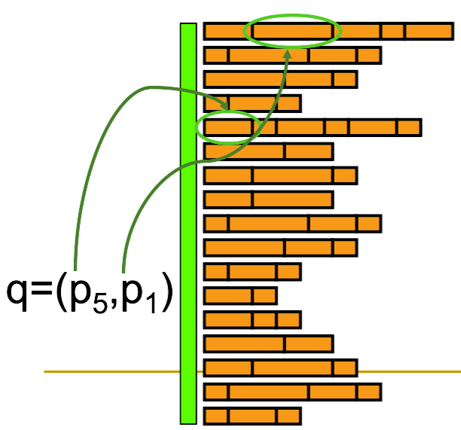
n_pivots
Controls the number of posting lists in the MIFile.
k_x
At indexing time, insert only the k_x nearest pivots to the data point, reducing the length of posting lists.
k_s
At search time, we access only the posting lists of the k_s pivots nearest to the query.
mdp
Maximum distance of position. We access the part of the posting lists containing positions in [q-mdp, q+mdp],
where q is the position of the query.

